Slide 1
Chapter 3
Histograms: Looking at the Distribution of the Data
Elsevier/Academic Press
© Andrew F. Siegel, 2016

Slide 2
Histogram
A Picture of a list of numbers
BARS ARE HIGH when many elementary units fall within this range
Shows typical value (center), dispersion (variability), distribution shape, outliers (if any)
Data
11 15
8 26
10 5
15
4
3
Frequency
2
1
0
0
10
20
30
Data value
Elsevier/Academic Press
© Andrew F. Siegel, 2016

Slide 3
Histogram
A Picture of a list of numbers
BARS ARE HIGH when many elementary units fall within this range
Shows typical value (center), dispersion (variability), distribution shape, outliers (if any)
Normal
distribution
Data
11 15
8 26
10 5
15
4
3
Frequency
2
1
0
0
10
20
30
Data value
Elsevier/Academic Press
© Andrew F. Siegel, 2016

Slide 4
Distribution Shapes (Ideal)
Normal
  Symmetric
  Bell-Shaped
Skewed
  Not symmetric
  Can cause trouble
  Transform? Logarithm?
Bimodal
  Two clear groups
  Find out why!
  Analyze separately?
Elsevier/Academic Press
© Andrew F. Siegel, 2016

Slide 5
Idealized Normal Distributions
Can shift center, width (diversity) of distribution
In idealized form, without the randomness of data
Elsevier/Academic Press
© Andrew F. Siegel, 2016

Slide 6
Data from a Normal Distribution
All are sampled from the same idealized normal distribution. Note the random differences.
30
30
20
20
Frequency
Frequency
10
10
0
0
60
80
100
120
140
60
80
100
120
140
30
30
20
20
Frequency
Frequency
10
10
0
0
60
80
100
120
140
60
80
100
120
140
Elsevier/Academic Press
© Andrew F. Siegel, 2016

Slide 7
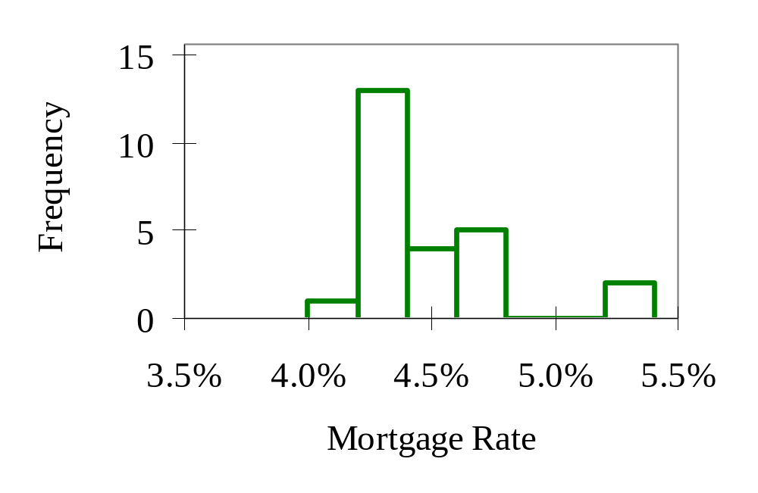
Example: Mortgage Interest Rates
Fig 3.2.1
Values from about 4.0% to 5.4%
Typical: from about 4.2% to 4.8%
Diversity among institutions
Special feature: gap from 4.8% to 5.2%
Elsevier/Academic Press
© Andrew F. Siegel, 2016

Slide 8
Histogram and Bar Chart
Histogram is a bar chart of the frequencies of the data
  Histogram: bar height represents number of cases within the range
  Ordinary bar chart: bar height represents data value for just one case
Histogram shows overall distribution
  Histogram: the “big picture” of patterns in the data
  Ordinary bar chart: often too much detail (each individual case)
Elsevier/Academic Press
© Andrew F. Siegel, 2016

Slide 9
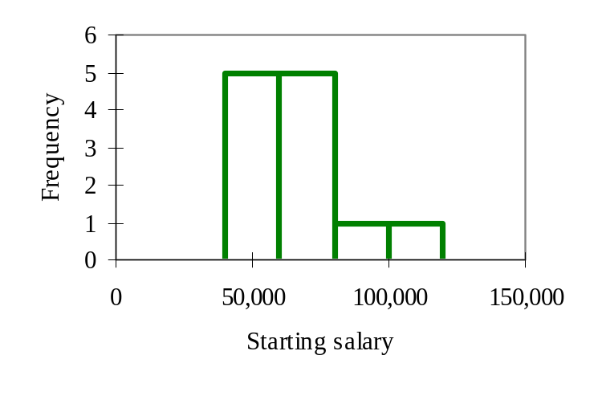
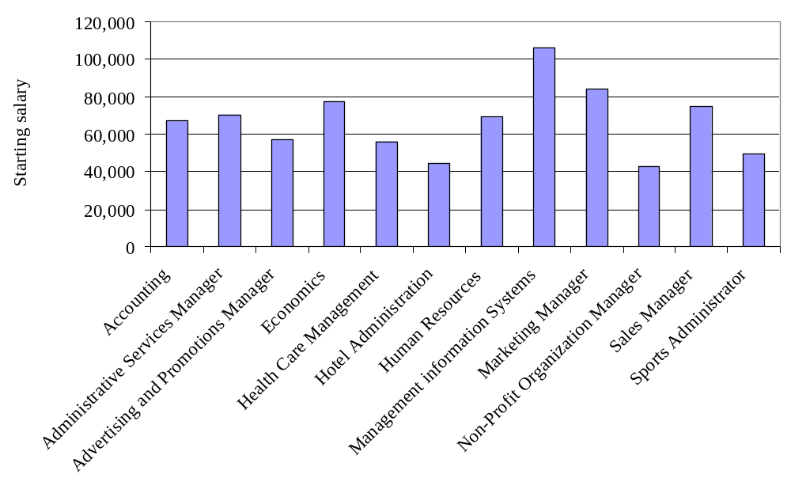
Histogram and Bar Chart for Salaries
Fig 3.2.2-3
Histogram shows patterns in the frequencies
Ordinary Bar chart shows all cases individually
For large data sets, histogram is much more useful
Elsevier/Academic Press
© Andrew F. Siegel, 2016

Slide 10
Idealized Skewed Distributions
Not symmetric
Various shapes are possible
In idealized form, without the randomness of data
Elsevier/Academic Press
© Andrew F. Siegel, 2016

Slide 11
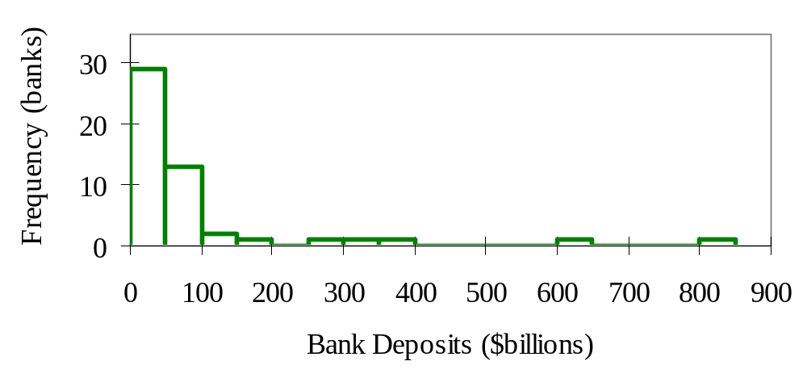
Example: Bank Deposits
Fig 3.4.2
Most banks are smaller: tall bars at the left
A few banks are larger (to the right)
A skewed distribution
JPMorgan Chase
Bank of America
Elsevier/Academic Press
© Andrew F. Siegel, 2016

Slide 12
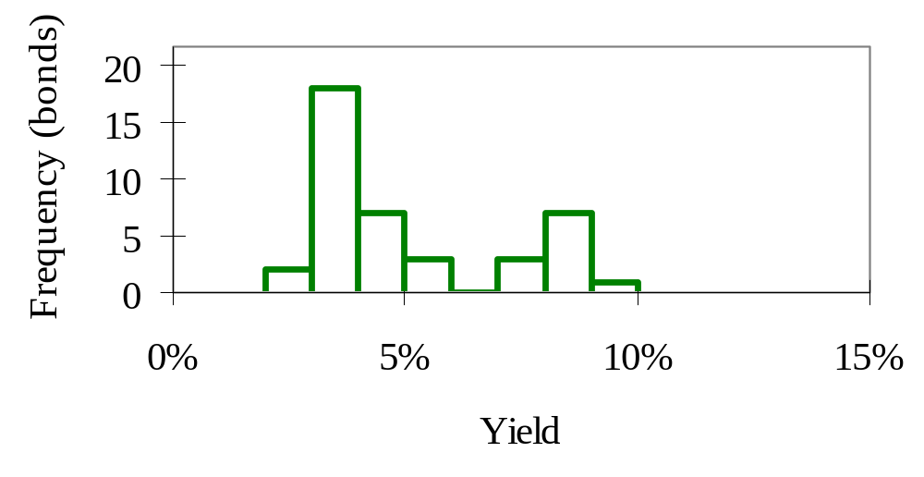
Bimodal Distribution
Fig 3.5.1
Two distinct groups in the data (ask “why?”)
Example: Corporate Bonds rated AA and B
  Low-risk bonds have a lower yield
  High-risk bonds entice investors with a higher yield
Elsevier/Academic Press
© Andrew F. Siegel, 2016

Slide 13
Outlier
A data value very different from the others
Difficult to see distribution of most of the data, even after changing histogram scale
Defects
11 19
23 15
18 19
13 268
25 9
10
8
Frequency
Frequency
0
0
0
100
200
300
0
100
200
300
Elsevier/Academic Press
© Andrew F. Siegel, 2016

Slide 14
Outlier: What to Do?
Note the outlier. If error, then fix it
(Perhaps) analyze with and without outlier(s)
  If similar answers, then no problem
OK to omit outlier(s) IF not part of situation under study
  e.g., Lab analysis, dropped test tube
    OK to omit, if studying normal operation, not laboratory accidents
  e.g., Statistical audit, “special occurrence” error
    Use care. Such an error in a sample may represent other “explainable” errors in accounts that were not examined
Elsevier/Academic Press
© Andrew F. Siegel, 2016

Slide 15
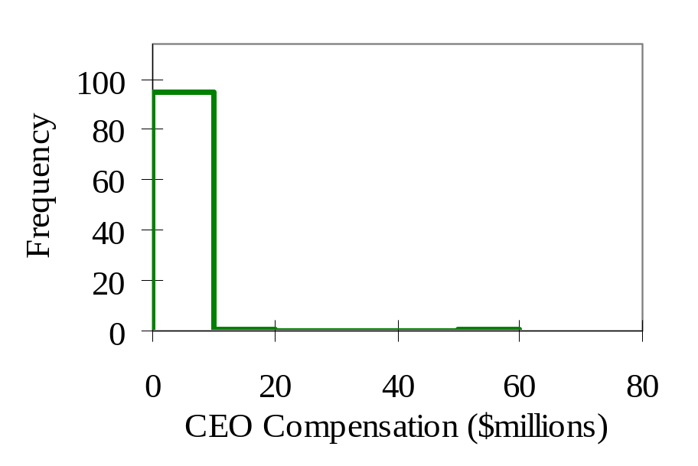
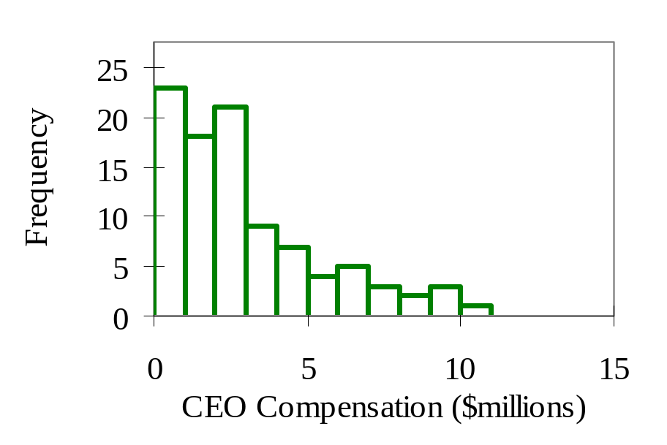
Example: Software CEO Compensation
Fig 3.6.1, 4
One CEO (Ellison of Oracle) made $56.81 million
Removing this outlier, we can see more detail
Elsevier/Academic Press
© Andrew F. Siegel, 2016

Slide 16
Data Mining Promotions Received
Fig 3.7.1
Number of promotions received by 20,000 people in the donations database
3,000
2,000
Number of people
1,000
0
0
50
100
150
200
Promotions
Elsevier/Academic Press
© Andrew F. Siegel, 2016

Slide 17
More Detail in Promotions
Fig 3.7.2
Reduce bar width from 10 to 1 promotion
With large data set, can see interesting structure
  such as the peak at about 15 promotions
600
500
400
Number of people
300
200
100
0
0
20
40
60
80
100
120
140
160
180
Promotions
Elsevier/Academic Press
© Andrew F. Siegel, 2016

Slide 18
Data Mining Donations
Fig 3.7.3
Size of donation received in response to mailing
Note: many donations of $0 among these 20,000
  Difficult to see anything else! (six donated $100)
20,000
15,000
Number of people
10,000
5,000
0
$0
$20
$40
$60
$80
$100
$120
Donation
Elsevier/Academic Press
© Andrew F. Siegel, 2016

Slide 19
More Detail in Donations
Fig 3.7.4
Keep only the 989 who donated (eliminate $0)
  to see detail among those who made a gift
Can now see the distribution of the gift amounts
300
250
200
Number of people
150
100
50
0
$0
$20
$40
$60
$80
$100
$120
Donation
Elsevier/Academic Press
© Andrew F. Siegel, 2016

Slide 20
Even More Detail in Donations
Fig 3.7.5
With so much data (989 people)
  we can use smaller bars to see more details
Note the “spikes” at $5, 10, 15, 20, 25, and 50
200
150
Number of people
100
50
0
$0
$20
$40
$60
$80
$100
$120
Donation
Elsevier/Academic Press
© Andrew F. Siegel, 2016

